Slide 1
Championing the founders who are redesigning the Everyday Economy.
Seed Stage Pitch Deck Outline
CONFIDENTIAL
NextViewVentures.com

Slide 2
Team Slide
NAME
Title
NAME
Title
NAME
Title
Role/Expertise
Role/Expertise
Role/Expertise
Role/Expertise
Role/Expertise
Role/Expertise

Slide 3
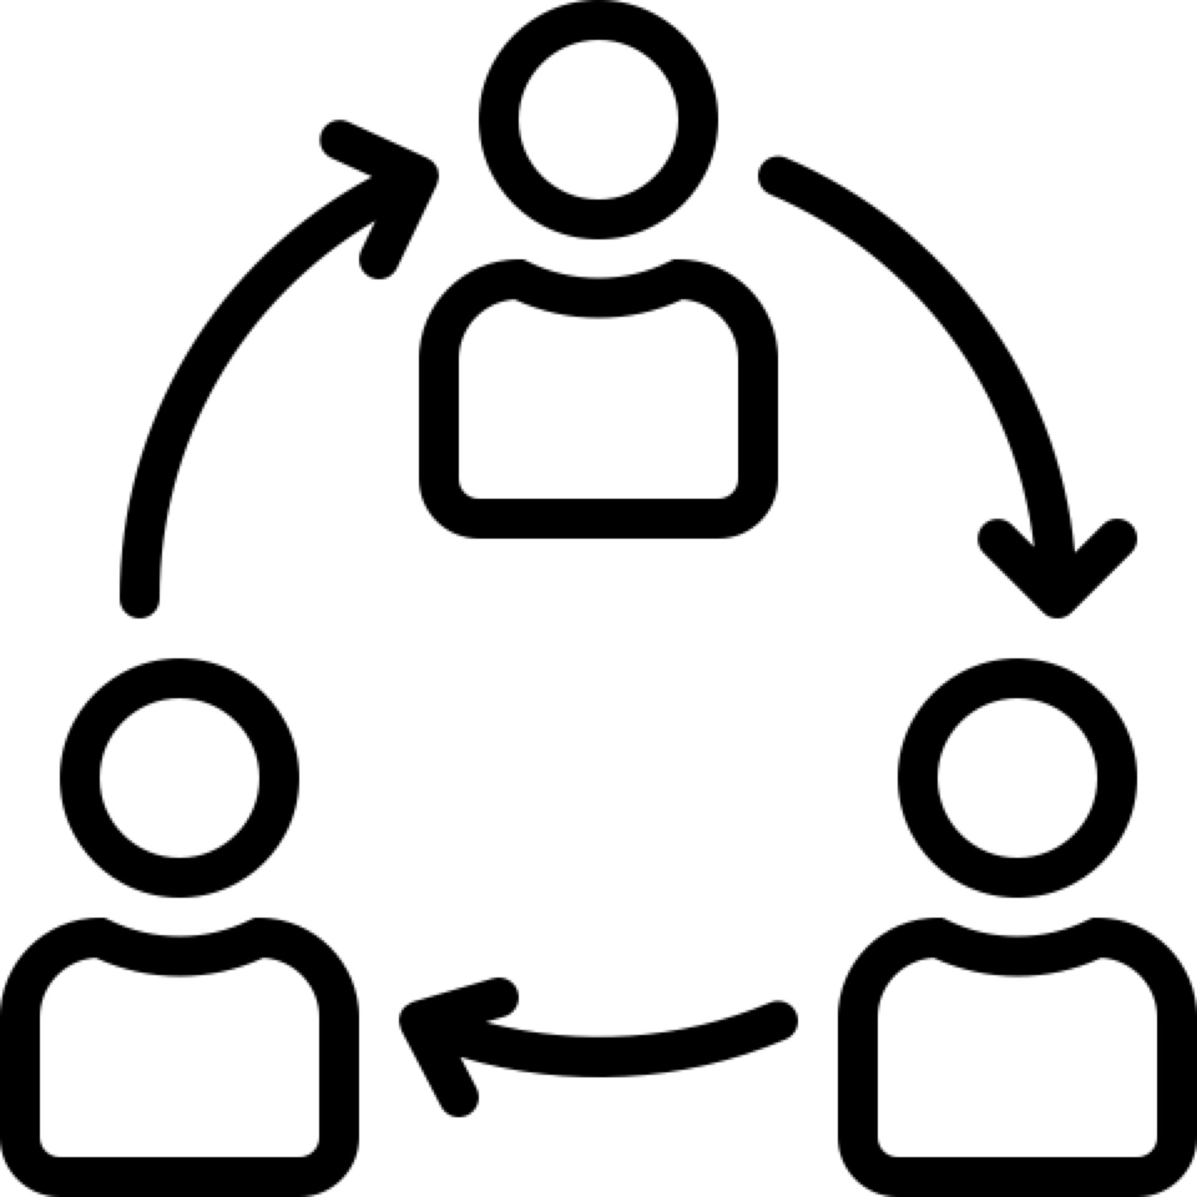
Tip:
You want a 1-2 sentence statement about what you are doing, along with some visual cues that help illustrate the point or lend credibility to your business.
This can be a combination of screenshots, customer logos (eg: already trusted by brands like…), a workflow diagram, or an illustration.
Concrete Explanation
Of Problem
What Do You Do?
“Write a 1-2 sentence statement about what you are doing”
1
Explanation of
Actions Taken
2
PRODUCT SHOTS
Explanation of
Outcomes

Slide 4
Tip:
Seed-stage investors understand there won’t be tons of traction just yet, but it’s important to convey a few data points and whatever loose proof you have that hints at success.
Is It Working?
Traction Metric 1
Traction Metric 2
Show 2 to 3 traction metrics or a couple of stats to support 1 higher level chart.
Traction Metric 3

Slide 5
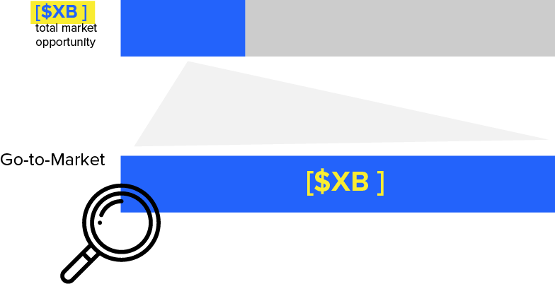
Tip:
The “Why Does It Matter” slides should be 2-3 slides on market size or opportunity and the importance of what your company is doing (ex. Potential market and impact).
Why Does It Matter?
We think there are three topics one could cover in these slides:
Is this (or will this) be really big?
Why now?
Why is this strategic?

Slide 6
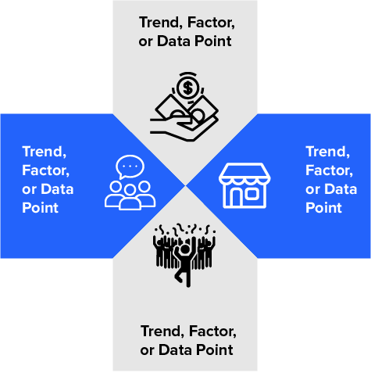
Why Does It Matter?
Related Data Points
Data point/statement (Source)
Data point/statement (Source)
Data point/statement (Source)
Data point/statement (Source)
Data point/statement (Source)
Data point/statement (Source)
Data point/statement (Source)
Data point/statement (Source)
Data point/statement (Source)

Slide 7
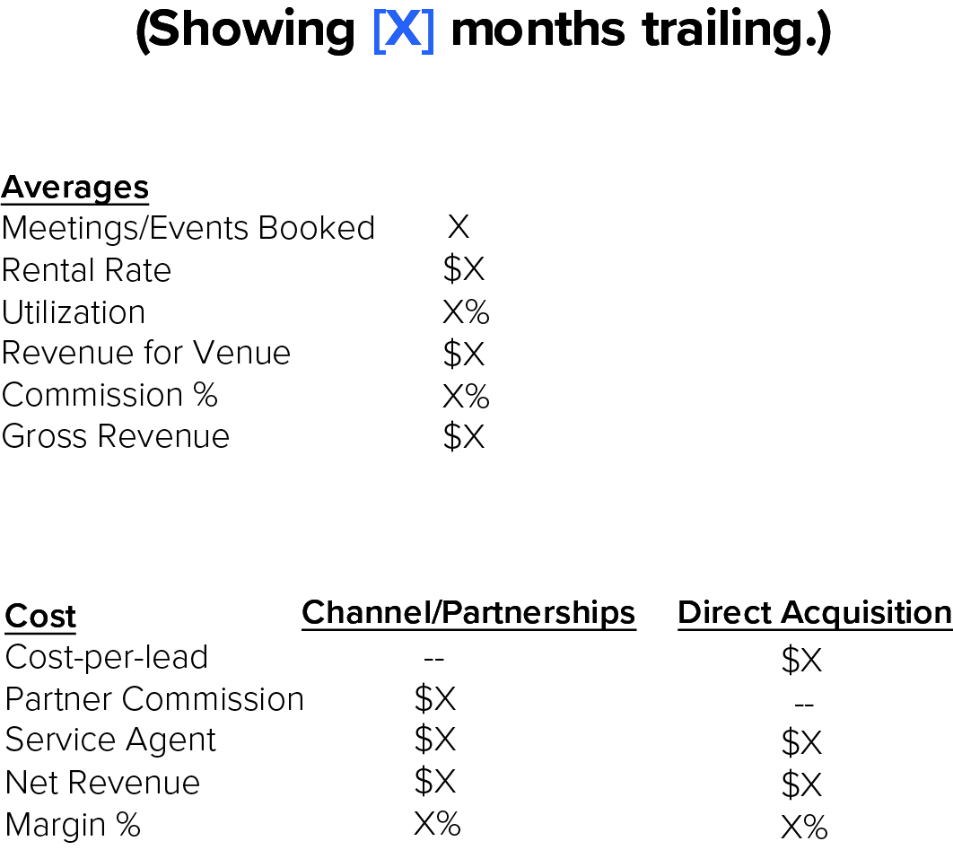
Can You Be The Best?
Tip:
Use these slides as an additional layer of credibility. Choose your 2-3 strongest assets (marketing, retention, customer approval, sales, etc.) and show why they’re important.

Slide 8
Tip:
You can highlight more wins in the appendix section, but try to wow with 2 or 3 metrics.
Can You Be The Best?
Retention Rates
Sales Pipeline
NPS Score

Slide 9
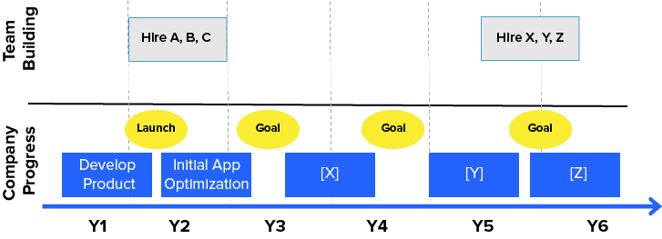
Tip:
Use this slide to discuss
your multi year plan for the product.
Once you get to this part of the pitch, investors are trying to get a few things out of this slide:
The “people roadmap”
The “product roadmap”
Milestones - what do you plan to accomplish with #1 and #2
Where Are You Going?

Slide 10
Tip:
While there’s a place for the full financials in the appendix, a top-level outline around how the capital will be allocated, as well as goal milestones to be accomplish with this set of financing should be included on this slide.
What Do You Want?
We are seeking [$X].
We aim to [major goals] in the next [timeframe].
Build team of [X]
[Biggest product milestone – e.g. launch beta in X months]
Product/market fit and [X customers/users] in [X] months

Slide 11
Appendix
Seed Stage Pitch Deck Outline
CONFIDENTIAL
NextViewVentures.com

Slide 12
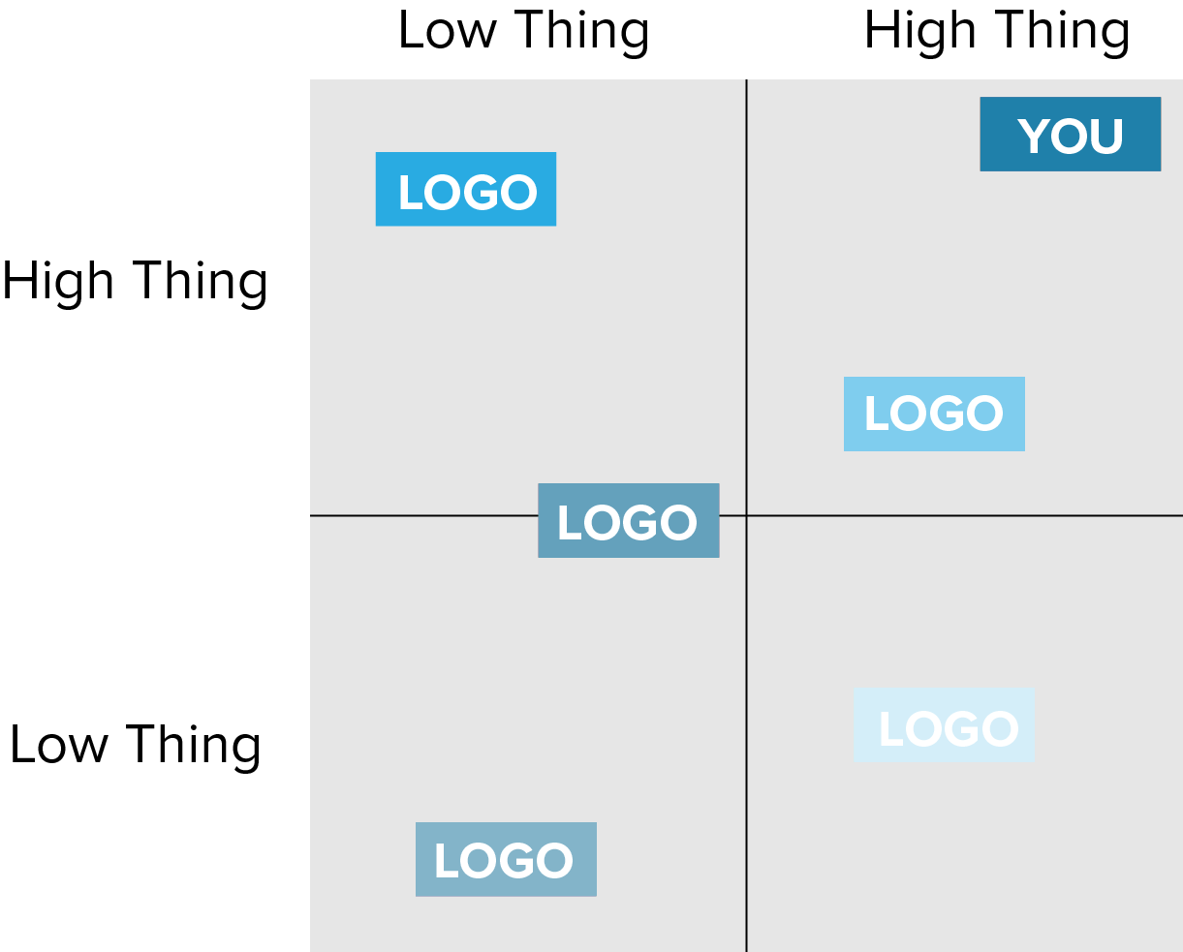
Competition
Answer the question:
Why hasn’t this
worked in the past?

Slide 13
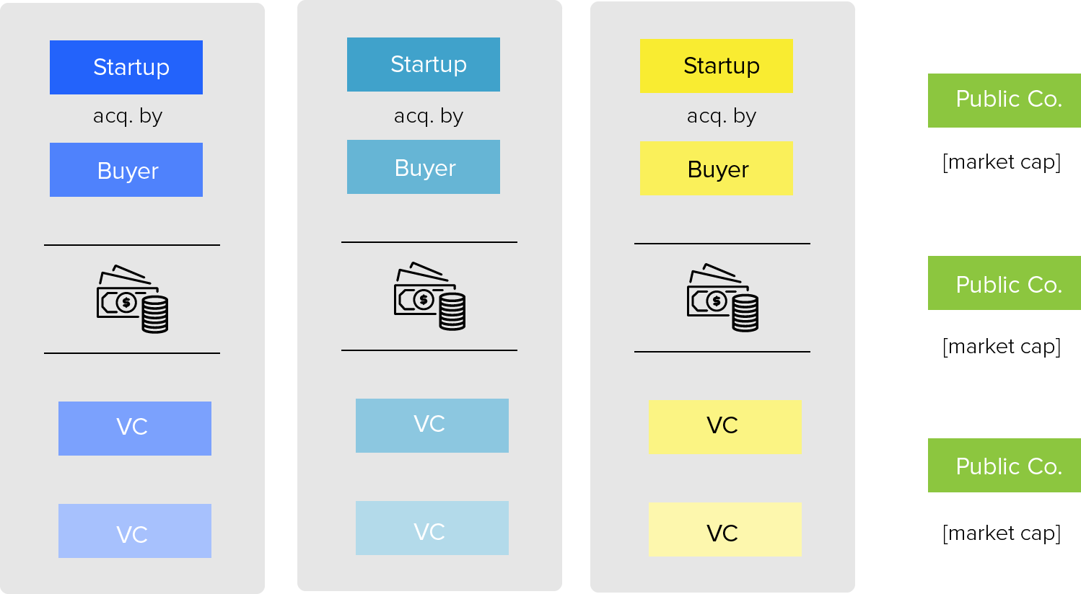
Exit
Comparisons

Slide 14
Revenue Q1 Q2 Q3 Q4 Year1 Q1 Q2 Q3 Q4 Year2
Item $X $X $X $X $X $X $X $X $X $X
Item $X $X $X $X $X $X $X $X $X $X
Total Revenue $X $X $X $X $X $X $X $X $X $X
Cost of goods sold
Item $X $X $X $X $X $X $X $X $X $X
Item $X $X $X $X $X $X $X $X $X $X
Total COGs $X $X $X $X $X $X $X $X $X $X
Gross Profit $X $X $X $X $X $X $X $X $X $X
Gross Margin X% X% X% X% X% X% X% X% X% X%
Expenses
Item $X $X $X $X $X $X $X $X $X $X
Item $X $X $X $X $X $X $X $X $X $X
Total Expenses $X $X $X $X $X $X $X $X $X $X
EBITDA ($X) ($X) ($X) ($X) ($X) ($X) ($X) ($X) ($X) ($X)
Other Income (Loss) ($X) ($X) ($X) ($X) ($X) ($X) ($X) ($X) ($X) ($X)
Net Income (Loss) ($X) ($X) ($X) ($X) ($X) ($X) ($X) ($X) ($X) ($X)
Financials

Slide 15
Product Shots
3
1
2
4

Slide 16
Data Point
Data Point
Data Point
Traction Deep Dive

Slide 17
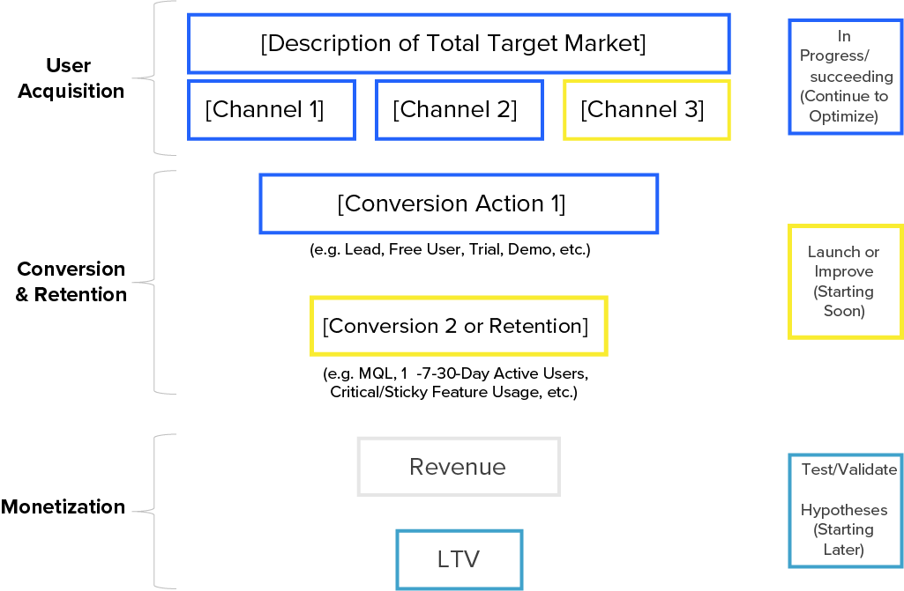
Marketing
Deep Dive
Tip:
In ONE slide, convey how you’ll drive growth through one of the following :
Your actual marketing funnel and results to date
Your product’s built-in growth drivers (referrals, network effects, etc.)
Proposed tactics you plan to deploy over time

