Slide 1


Championing the founders who are
redesigning the Everyday Economy.
Seed Stage Board Deck
Template
NextViewVentures.com

Slide 2
SAVE TIME, COMMUNICATE BETTER,
GET MORE DONE WITH YOUR BOARD.
The Goal: Stepping Up Your Board Game
Even at the seed stage, we believe it’s important to establish a board cadence. In doing so, you operate more professionally and strategically, you prepare for later stages when boards are required, and you get more from seed investors who can help you and champion your cause.

Slide 3
BEFORE THE MEETING
DURING THE MEETING
AFTER THE MEETING
  SEND YOUR DECK IN ADVANCE
  The 75% or more of your actual meeting should be about discussion and solving problems – not merely updating investors. Send your deck a couple days in advance so all directors can see the data and get initial context. This lets you dive into a more productive discussion, following a brief section of housekeeping and recapping the slides during the meeting.
  Additionally, design should be professional, but don’t agonize over beauty. Send as a PDF to preserve your fonts and layout.
  FOCUS ON 2-3 MAJOR ISSUES
  At first, immediately following your seed fundraise, most discussion will be about product direction and key hires. There may also be some early Series A commentary (which won’t be revisited until before your next fundraise process.)
  Other major topics to discuss:
  Go-to-market plans/tests
  Product/market fit data
  Setting/reviewing milestones
  Asking for/receiving help
  WHAT ARE THE ACTION ITEMS?
  Good board directors don’t merely hear your updates, poke and prod, then go about their days. They should be used to remove barriers, make intros, suggest solutions, and meet 1:1 where specific expertise or deeper discussion can be useful.
  Ensure everyone knows what they’re responsible for delivering and when.
  Additionally, if you’re entering your first board meeting, be sure you come away with a set cadence for the first 6-9 months of board meetings.

Slide 4
Board Meeting
mm. dd. yy
Seed Stage Board Deck
Template
NextViewVentures.com

Slide 5
AGENDA
Housekeeping
Progress Update
Financials
Team Update
Current Priorities
Key Concerns

Slide 6
EXAMPLE HOUSEKEEPING
Hiring
  Current org chart, with openings and requests for help
Office & Logistics
  Potential moves and cost (rent, $ per sq. ft., lease length)
  Insurance, healthcare, legal & other service providers
Approval of Meeting Minutes (if in use)
Financials:
  Cash out date and burn rate
  409A valuation
  Cap tables
  Common/preferred stock dashboard
Any or all of these can appear in your Board Updates slides. These are important and recurring items, but they shouldn’t take up more than the first 30-60 minutes of the meeting.
T I P

Slide 7
EXAMPLE PROGRESS UPDATE
Highlights:
Update
  Context
Update
  Context
Update
  Context
Lowlights:
Update
  Context
Update
  Context
Update
  Context
T I P
This slide sets the tone for the meeting. You want to summarize the things that are going well and articulate a few key concerns. You’ll talk about everything later, but this helps surface a few major things to help focus the coming conversation.

Slide 8


EXAMPLE FINANCIALS
STOCK OPTION GRANTS
New Hire: (Name, Role)
  X shares = Y%
Current Employee: (Name, Role)
  X shares = Y%
  Rationale (e.g. “Founding team member”)

Slide 9
EXAMPLE FINANCIALS
 | (Month) | (Month)
Revenue | $N | $N
Operating Expense | $N | $N
Net Income | $N | $N
Cash Burn | $N | $N
Cash Balance: $N
Cash Out Date: MM/YY
Notable in (Month):
e.g. “Increase in payroll, rent, legal fees”
e.g. “Decrease in marketing spend: events, paid Facebook”
It’s often a good idea to put a note next to the Cash Balance or Cash Out Date lines that shares whether your burn is consistent with plan or you’re spending more/less aggressively.
T I P

Slide 10





TEAM UPDATE
Amy
Co-Founder, CEO
Bob
Co-Founder, CTO
Matt
Lead Developer
Tracy
Web Developer
Jim
Sales/Marketing
(Next Hire)
UA Marketer
(Intern Hire)
Designer
T I P
This can go in the front or back of the deck. We prefer front because it’s easier to get through quickly and focus the rest of the discussion on the 1-2 most important issues.

Slide 11
TEAM COMPENSATION
Name | Role | Base Salary | Equity | Share Count | Start Date
Amy | CEO | $N | $X% | X | M/D/Y
Bob | Head of Product | $N | $X% | X | M/D/Y
Matt | Lead Developer | $N | $X% | X | M/D/Y
Tracy | Web Developer | $N | $X% | X | M/D/Y
Jim | Sales/Marketing | $N | $X% | X | M/D/Y
TBD Hire | UA Marketer | To approve: $N | To approve: $X% | X | M/D/Y
TBD Intern | Designer | $N | (small to none) | X | M/D/Y
Typically, the board directors (and your first few employees) think about equity percentages. As you grow, however, compensation starts to reference share counts. After all, at the seed stage, the dollar amount is less meaningful than the percentages, which reverse at a later-stage startup earning revenue.
T I P

Slide 12
CURRENT PRIORITIES
Your progress updates will be the most customized to your business. Rather than propose one generic layout, we’re showing three directionally correct layouts, each for a specific scenario:
A pre-launch startup.
A post-launch, pre-revenue consumer mobile startup.
An early-revenue SaaS startup.
These slides might be mainly text, mainly graphs, or a combination.
They also might be broken up across multiple slides.

Slide 13
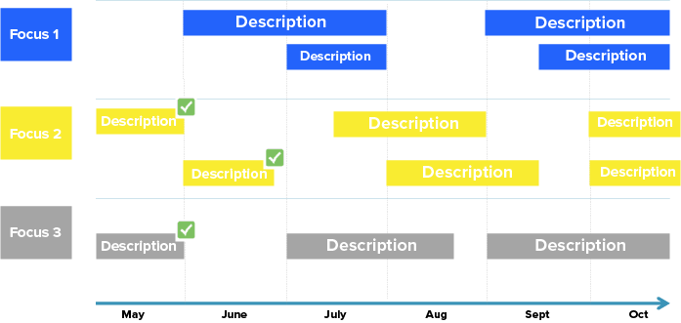
PRODUCT ROADMAP
T I P
To demo at the meeting: X update, Y update, Z update
In design/dev now: A update, B update, C update

Slide 14



USER PERSONAS
“Busy Betty”
Female (30s/40s), driven professional, values her time
Uses many apps to save time
Passive on social; active on blogs (lifestyle/hacks, business)
“Digital Dana”
Female & male (20s), young professional, time-waster
Serial app adopter/dropper (mostly entertainment)
Hyperactive on social media
“Casual Cara”
Female (30s/40s), primary driver is family, not career
Makes time for leisure (reading, watching, listening, apps, etc.)
Very active on Facebook only
TESTS PLANNED – 3 MONTHS
Offline/Local (events + flyers) – nonscalable tactics to acquire first cohort & learn
Facebook + Instagram – multivariate testing of messaging + audience targeting
Lifestyle Blogger Outreach – built target list of 100 (5 in draft now; 3 published)
Google AdWords – targeting longtail keywords on specific brands, trends
Paid content placement – targeting lifestyle/fashion sites → blog post housed on optimized landing page

Slide 15
USER TESTING
Logo (if B2B)
or Headshot (B2C)
“Revealing Quote”
Surveyed X User Prospects
  (How we found them)
  (What we hoped to learn)
Logo (if B2B)
or Headshot (B2C)
“Revealing Quote”
Key Insights
Early on, before you have a firm idea of who you’re targeting, you should form a few hypotheses which you then test. Once there’s traction, you can focus more resources on that user.
T I P

Slide 16
USER TESTING
We thought we were selling to X customer but now believe Y is a better target
  (How you plan to prove/disprove this thesis)
Prioritizing X feature higher on product roadmap
  (Why?)
Passionate responses to X, not Y
    (Early hypotheses as to why)
X moved in the market which changes Y
    (What was it? e.g. Facebook just launched XYZ)
T I P
These examples are generally the “so what?” moments from the previous slide. How has what you’ve learned thus far affected your approach to customers/GTM, product, or overall market or competitive landscape? Discuss with your board.

Slide 17
CURRENT PRIORITIES
A pre-launch startup.
A post-launch, pre-revenue consumer mobile startup.
An early-revenue SaaS startup.

Slide 18
GROWTH
(KPI 1)
(KPI 2)
Commentary
as needed
Commentary
as needed
T I P
Brief summary of what this data means and what resulting actions you’ll take. (Discuss in the meeting if needed.)

Slide 19
ENGAGEMNT
(List important top-of-funnel action)
Q2: 10.6%
Q1: 10.1%
← Flat Q2Q & below target.
Growing is Priority #1.
(middle-of-funnel action)
Q2: 23.2%
Q1: 15.1%
← Higher than anticipated
(middle-of-funnel action)
Q2: 3.3%
Q1: 3.9%
← Watching carefully but growing Priority #1 takes precedent today.
(bottom-of-funnel action)
Q2: 8.2%
Q1: 4.0%
← Doubled Q2Q after X product update, discussed last meeting.
Post-Launch,
Pre-Revenue
Consumer Mobile

Slide 20
PRODUCT ROADMAP
T I P
To demo at the meeting: X update, Y update, Z update
In design/dev now: A update, B update, C update

Slide 21
TAKEAWAYS & ACTION ITEMS
X channel is doing great; forward invest in it
  (Or, “Best channel starting to fail. Why? What do we test next?”)
Engagement changed significantly (+ or –)
  (Why? What does it mean)
Product roadmap changes
    (What updates/shuffling will happen based on previous slides?)
Broader Discussion: Are things working?
    (What does board see elsewhere? Benchmarks?)
The last point here is a sort of “meta” question. It’s good to discuss with the board whether the business “machine” is starting to work well or not in general. For instance, if you’re getting 2% growth week over week and daily active users to monthly active users is 15%, that’s not great. Your board will have context on these things. And you can discuss openly if this is good/bad/ok and whether current traction and financials will get you where you want to go.
T I P

Slide 22
CURRENT PRIORITIES
A pre-launch startup.
A post-launch, pre-revenue consumer mobile startup.
An early-revenue SaaS startup.

Slide 23
Template 1 of 2:
Full Slide Deck
KPI DASHBOARD
Going Well/Advantages:
Top-line growth: $300K Q1 (record quarter)
Retention: 0.5% churn
CAC: Improved to $X
ASP: $X
Early sales process implemented + strong initial results
Product NPS of 85
New features (X & Y): strong qual. feedback + early adoption
Concerns/Risks:
Biggest acquisition channel (XYZ) slowing
Top-of-funnel marketing (site traffic down 15%; net new leads down 25%)
Sales/marketing alignment
When to hire for customer success
For early-stage cos, you’re trying to get a feel for the unit economics, aka tune the machine. CAC/LTV over time, churn over time, avg. selling price, etc. are all part of that.
T I P

Slide 24
Template 1 of 2:
Full Slide Deck
SALES DISCUSSION
QTD Sales Results
(Trend of note; e.g. X new deals / $N new $ACV from Y channel)
(Trend of note; e.g. X customers from Y specific industry)
Total: $300K total bookings in Q1 – 105% of goal
Pipeline
(Trend of note; e.g. net new lead flow down QoQ)
(Trend of note; e.g. total MQLs / opportunities strong despite lead flow)
Focus is
Org Updates
(New hires, promotions, quota changes, process changes, etc.)
Notes:
You also want to take 1-2 KPIs from the previous slide to go deeper and have an open discussion. For instance, here are a few slides on revenue growth.

Slide 25
SALES OPPORTUNITIES
Commentary
as needed
Commentary
as needed
High-level analysis of the data.
1-2 important things to know or discuss re: your creation of sales opportunities.
Upcoming action items/tests to discuss.
T I P

Slide 26
Template 1 of 2:
Full Slide Deck
MARKETING FUNNEL
N
Overall Site Traffic
Commentary
as needed
Leads Captured
N
Commentary
as needed
Leads-to-MQL
N
MQL-to-SQL
N
High-level analysis of the data.
1-2 important things to know or discuss re: your top-of-funnel marketing.
Upcoming action items/tests to discuss.
T I P

Slide 27
GROWTH MACHINE
Marketing
Update / Win / Concern
Update / Win / Concern
Update / Win / Concern
Sales
Update / Win / Concern
Update / Win / Concern
Update / Win / Concern
Product
Update / Win / Concern
Update / Win / Concern
Update / Win / Concern
Plan to discuss only a few of the major items here. In general, you’re answering three questions (read top to bottom on this slide): How are you generating demand? How are you converting demand? How are people engaging the product?
T I P

Slide 28
PRODUCT PERFORMANCE
NPS
N
Account Activation
N% register → usage
Usage
7 Day: N%
30 Day: N%
Feature Pipeline
Recently Implemented: X, Y, Z
4-6 Months: X, Y, Z
6+ Months: X, Y
“Key quote as qualitative data point.”
-- Customer, Business

Slide 29
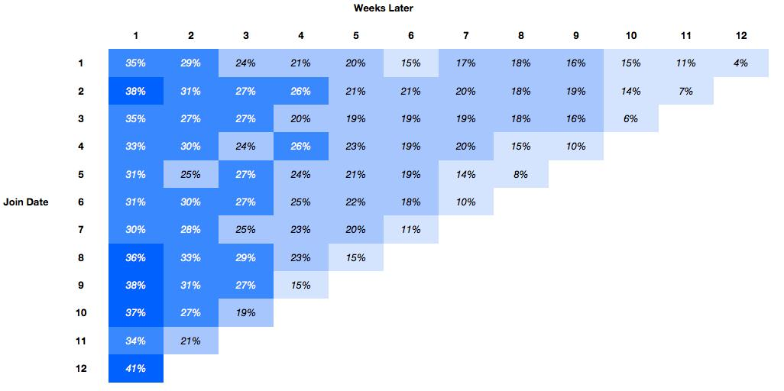
Template 1 of 2:
Full Slide Deck
EARLY COHORT ANALYSIS
T I P
Although you’ll lack this much data initially, it’s critical to begin tracking by cohort and to measure each cohort’s engagement over time.

Slide 30
PRODUCT ROADMAP
T I P
To demo at the meeting: X update, Y update, Z update
In design/dev now: A update, B update, C update

Slide 31
KEY CONCERNS & REQUESTS
Concern/request #1
Concern/request #2
Concern/request #3
It’s crucial to be as transparent as possible early on. It both sets the tone for your board relationship and helps you gain valuable advice and support. Early board meetings aren’t simply investor updates.
T I P

Slide 32
RUNNING UPDATE TEMPLATE
FOR BOARD UPDATES
AFTER SEED FUNDRAISING
T I P
This is less formal but keeps your board current. Because the doc can be annotated by all parties, it helps CEOs and board members have a productive, iterative discussion rather than a one-way information dump.

Slide 33
RUNNING UPDATE TEMPLATE
Instead of a full deck, you might compile a running log of important updates, with a summary at the top. In some cases, your board may also like to annotate different sections before the meeting and flag various topics to discuss or clarify further.
Click here to view the update document.
This can be sent as an email, or a living document.

